Slide 1
CS 408
Computer Networks
Chapter 08: Internet Protocols

Slide 2
Some basics
The term internet is short for “internetworking”
  interconnection of networks with different network access mechanisms, addressing, different routing techniques, etc.
An internet
  Collection of communications networks interconnected by layer 3 switches and/or routers
The Internet - note the uppercase I
  The global collection of individual machines and networks
IP (Internet Protocol)
  most widely used internetworking protocol
  foundation of all internet-based applications

Slide 3
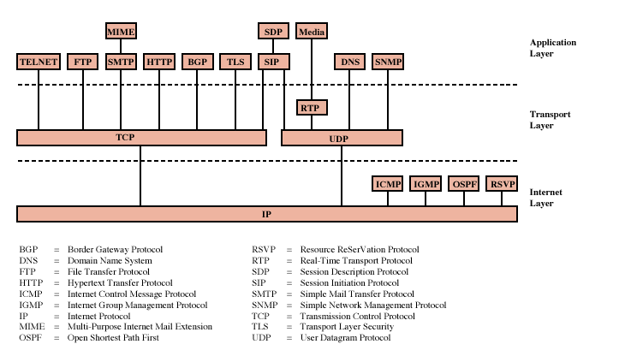
Protocols of TCP/IP Protocol Suite

Slide 4
Internet Protocol (IP)
IP provides connectionless (datagram) service
Each packet treated separately
Network layer protocol common to all routers
  which is the Internet Protocol (IP)

Slide 5
Connectionless Internetworking (General)
Advantages
  Flexible and robust
    e.g. in case of congestion or node failure, packets find their way easier than connection-oriented services
  No unnecessary overhead for connection setup
  Can work with different network types
    does not demand too much services from the actual network
Disadvantage: Unreliable
  Not guaranteed delivery
  Not guaranteed order of delivery
    Packets can take different routes
  Reliability is responsibility of next layer up (e.g. TCP)

Slide 6
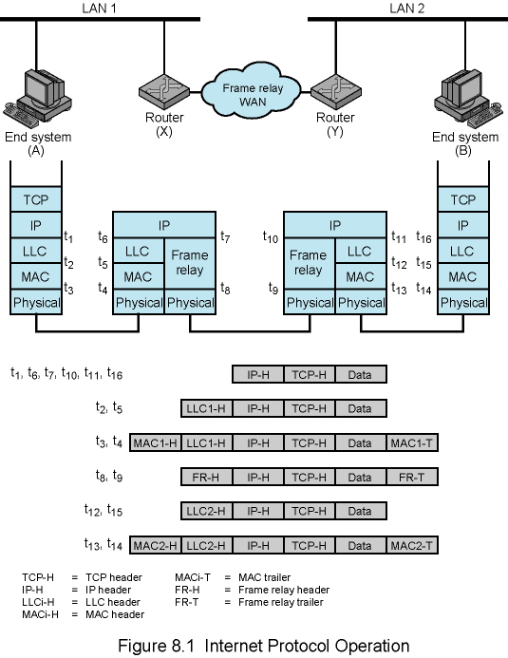
Example Internet Protocol Operation

Slide 7
Design Issues
Routing
Datagram lifetime
Fragmentation and re-assembly
Error control
Flow control
Addressing

Slide 8
Routing
End systems and routers maintain routing tables
  Indicate next router to which datagram should be sent
  Static
    Tables do not change but may contain alternative routes
  Dynamic
    If needed, the tables are dynamically updated
    Flexible response to congestion and errors
    status reports issued by neighbors about down routers
Source routing
  Source specifies route as sequential list of routers to be followed
  useful, for example, if the data is top secret and should follow a set of trusted routers.
Route recording
  routers add their address to datagrams
  good for tracing and debugging purposes

Slide 9
Datagram Lifetime
Datagrams could loop indefinitely
  Not good
    Unnecessary resource consumption
  Need an upper bound on datagram life
Datagram marked with lifetime
  Time To Live (TTL) field in IP
  Once lifetime expires, datagram discarded (not forwarded)
  Hop count
    Decrement time to live on passing through each router
  Time count
    Need to know how long since last router
    global clock is needed

Slide 10
Fragmentation and
Re-assembly
Different maximum packet sizes for different networks
  routers may need to split the datagrams into smaller fragments
When to re-assemble
  At destination
    Packets get smaller as data travel
      inefficiency due to headers
  Intermediate reassembly
    Need large buffers at routers
    All fragments must go through same router
      Inhibits dynamic routing

Slide 11
IP Fragmentation
In IP, reassembly is at destination only
Uses fields in header
  Data Unit Identifier – In order to uniquely identify datagram – all fragments that belong to a datagram share the same identifier
    Source and destination addresses
    Upper protocol layer (e.g. TCP)
    Identification supplied by that layer
  Data length
    Length of user data in octets (if fragment, length of fragment data)
    Actually header contains total length incl. header but data length can be calculated
  Offset
    Position of fragment of user data in original datagram (position of the first byte of the fragment)
    In multiples of 64 bits (8 octets); i.e. one unit of offset is 8 octets.
  More flag
    Indicates that this is not the last fragment (if this flag is 1); otherwise, last fragment
Part of IP header

Slide 12
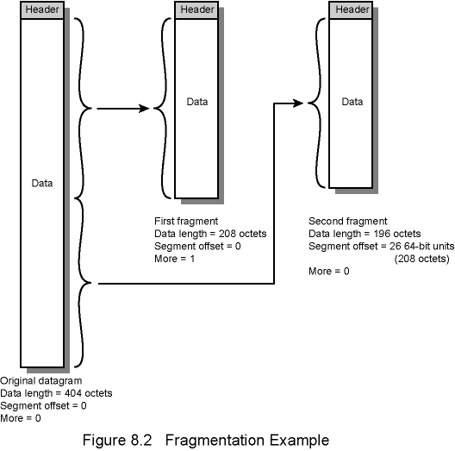
Fragmentation Example

Slide 13
Dealing with Failure
Reassembly may fail if some fragments get lost
Need to detect failure to free up the buffers
One solution: Reassembly time out
  Assign a reassembly lifetime to the first fragment
  If timer expires before all fragments arrive, discard partial data

Slide 14
Error Control
In IP, delivery is not guaranteed
Router may attempt to inform source if packet discarded, if possible
  specify the reason of drop, e.g. for time to live expiration, congestion, bad checksum (error detected)
Datagram identification needed
When source receives failure notification, it
  may modify transmission strategy
  may inform high layer protocol
Note that such a failure notification is not guaranteed

Slide 15
Flow Control (in IP layer)
Allows preceeding routers and/or stations to limit rate of incoming data
In connectionless systems (such as IP), flow control mechanisms are limited
Sending flow control packets requesting reduced flow
  no fine tuning such the one in sliding window protocols; coarse-grained mechanism
  e.g. using source quench packet of ICMP

Slide 16
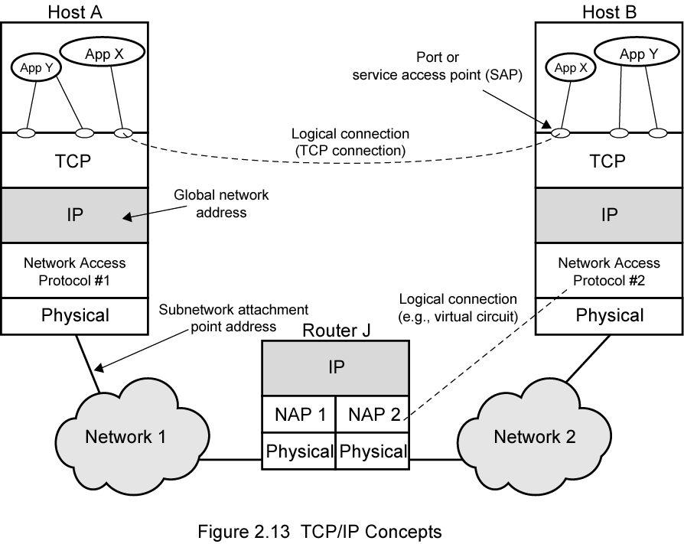
Addressing in TCP/IP
port

Slide 17
Internet Protocol (IP) Version 4
Part of TCP/IP
  Used by the Internet
Specifies interface with higher layer
  e.g. TCP
Specifies protocol format and mechanisms
RFC 791
  Dated September 1981
  Only 45 pages
Will (eventually) be replaced by IPv6 (see later)

Slide 18
IP Services
Information and commands exchanged across adjacent layers (e.g. between IP and TCP)
Primitives (functions to be performed)
  Send
    Request transmission of data unit
  Deliver
    Notify user of arrival of data unit
Parameters
  Used to pass data and control info
TCP/UDP
Deliver
Send
IP

Slide 19
Parameters (1)
Source IP address
Destination IP address
Protocol
  Recipient e.g. TCP
Type of Service Indicators
  Specify treatment of data unit during transmission through networks
Identification
  Uniquely identifies PDU together with source, destination IP addresses and user protocol
  Needed for re-assembly and error reporting

Slide 20
Parameters (2)
Don’t fragment indicator
  Can IP fragment data?
  If not, may not be possible to deliver
Time to live (initial TTL value)
Data length
Options
Data from/to upper layer

Slide 21
Type of Service Indicators
Requests for service quality
  now different QoS (Quality of Service) mechanisms are used, but this is out of scope of this course
Precedence
  8 levels
Reliability
  Normal or high
Delay
  Normal or low
Throughput
  Normal or high

Slide 22
Options
Security
  security label - mostly for military applications
Source routing
Route recording
Stream identification
  identifies reserved resources for stream traffic (like video)
Timestamping
  added by source and routers

Slide 23
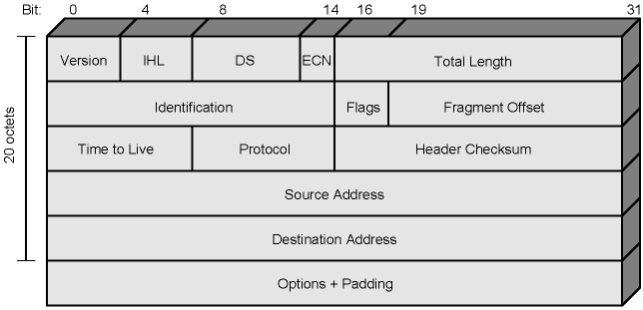
IPv4 Header

Slide 24
Header Fields (1)
Version
  Currently 4
  IP v6 - see later
IHL (Internet header length)
  Unit is 32 bit words
  Including options
  minimum 5 (means 20 octets)
DS (Differentiated Services) and ECN (Explicit Congestion Notification)
  previously used for “Type of Service”
  now used by (interpreted as) DS and ECN
  DS is for QoS support (that we will not cover)
  we will see the concept of Explicit Congestion Notification later

Slide 25
Header Fields (2)
Total length
  of datagram (header + data), in octets
Identification
  Sequence number
  Used with addresses and Protocol (upper layer) to identify datagram uniquely
Flags
  More bit
  Don’t fragment
Fragmentation offset
Time to live
Protocol
  Next higher layer to receive data field at destination

Slide 26
Header Fields (3)
Header checksum
  Verified and recomputed at each router
Source address
Destination address
Options
Padding
  To fill to multiple of 32 bits long

Slide 27
Data Field
User (upper layer) data
any octet length is OK
  But max length of IP datagram (header plus data) is 65,535 octets

Slide 28
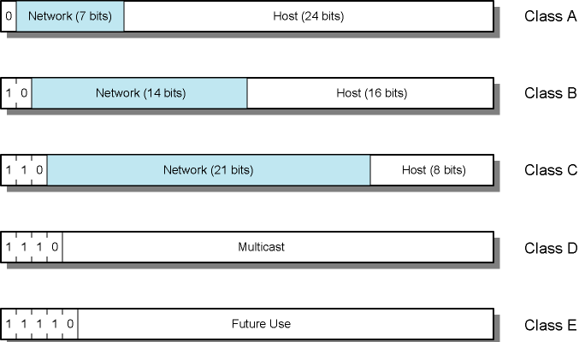
IPv4 Address Formats
32 bit global Internet address
Network part and host part
All-zero host part identifies the network
All-one host part means broadcast (limited to current network)

Slide 29
IP Addresses - Class A
Start with binary 0
7-bit network - 24-bit host
All zero
  Special meaning (means “this computer”)
01111111 (127) (network part ) reserved for loopback
  Generally 127.0.0.1 is used
Range 1.x.x.x to 126.x.x.x
  10.x.x.x is for private networks
Few networks - many hosts
All networks have been allocated

Slide 30
IP Addresses - Class B
Starts with binary 10
Range 128.x.x.x to 191.x.x.x
  Second octet is also part of the network id.
14-bit network, 16-bit host number
  2¹⁴ = 16,384 class B addresses
  2¹⁶ - 2 = 65,534 hosts per network
    Minus 2 is due to network and broadcast addresses
All networks have been allocated

Slide 31
IP Addresses - Class C
Start binary 110
Range 192.x.x.x to 223.x.x.x
Second and third octets are also part of network address
2²¹ = 2,097,152 addresses (networks)
256 – 2 = 254 hosts per network
Nearly all allocated

Slide 32
Some Special IP address forms
Prefix (network) | Suffix (host) | Type & Meaning
all zeros | all zeros | this computer (used during bootstrap)
network address | all zeros | identifies network
network address | all ones | broadcast on the specified network
all ones | all ones | broadcast on local network
127 | any | loopback (for testing purposes)

Slide 33
Subnets and Subnet Masks
Allow arbitrary complexity of internetworked LANs within organization
  By not having one network class for each LAN within the organization
  Each such LAN is called a subnet.
Such a network with several subnets looks like a single network from the point of view of the rest of internet
Each subnet is assigned a subnet number
Host portion of address partitioned into subnet number and host number
Local internal routers route within subnetted network
Subnet mask indicates which bits are network/subnet number and which are host number
  Subnet mask must be in the form of several 1's followed by several 0's (total 32 bits) - 111..111000…0
  number of 0's is used to determine the number of hosts in that subnet (see next example)

Slide 34
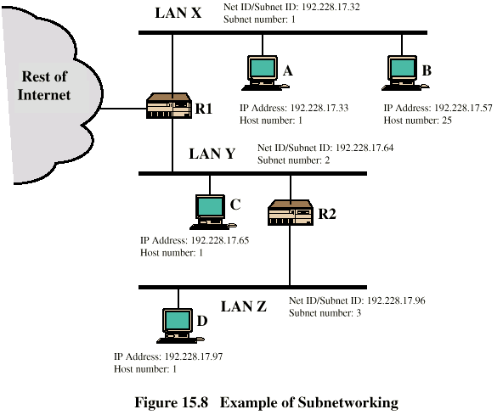
Routing Using Subnets (Example)
Subnet Mask:
255.255.255.224
Addresses start with 192, so class C addresses. Last octet is for Subnet number and Host number
224 -> 11100000 in binary ➔last 5 bits are for Host number, previous 3 bits are for Subnet number
Don't forget! All zero host number identifies the subnet and all ones is used for broadcast on that subnet

Slide 35
Classless Addresses
Extension of subnet idea to the whole Internet
Assigning IP numbers by partitioning network and host parts at any bit position
A precaution against exhaustion of IP addresses
Special notation (CIDR notation)
  network address/number of 1-bits in the mask
  e.g. 128.140.168.0/21
    subnet mask is 255.255.248.0
    Lowest host address?
    Highest host address?
Using classless addresses to generate several subnetworks will be explained in lab 4 and you will have a quiz on this.
Notes:
Lowest 128.140.168.1
Highest 128.140.175.254

Slide 36
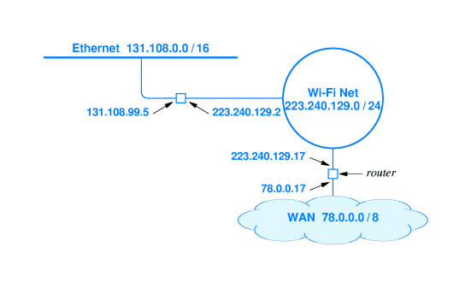
Example Network Configuration
IP address is the address of a connection (not of a computer or router)

Slide 37
ICMP
Internet Control Message Protocol - RFC 792
  Sister protocol of IP
  All IP implementations should also implement ICMP
Transfer of (control) messages from routers-to-hosts and hosts-to-hosts
Feedback about problems
  e.g. datagram discarded, router’s buffer full
Some simple applications can be implemented using ICMP
  e.g. ping
Read pages 287 – 290 for ICMP related mechanisms
Encapsulated in IP datagram
  Thus not reliable

Slide 38
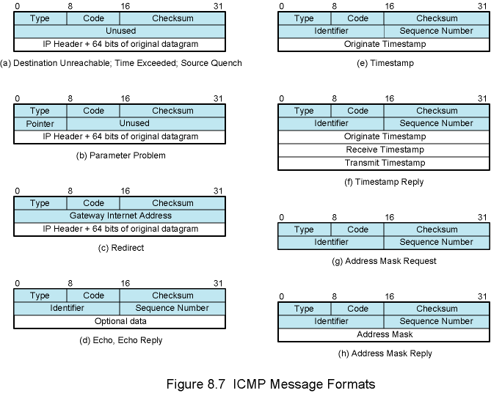
ICMP Message Formats

Slide 39
IP v6 - Version Number
IP v 1-3 defined and replaced
IP v4 - current version
IP v5 - stream protocol
  Connection oriented internet layer protocol
IP v6 - replacement for IP v4
  Not compatible with IP v4
  During the initial development it was called IPng (Next Generation)

Slide 40
Driving Motivation to change IP
Address space exhaustion
  Two level addressing (network and host) wastes space
  Growth of networks and the Internet
  Extended use of TCP/IP
    e.g. for POS terminals
    Wireless nodes
    Vehicles
    Current trend: Internet of Things

Slide 41
IPv6 RFCs
1752 - Recommendations for the IP Next Generation Protocol
2460 - Overall specification (December 1998)
2373 - Addressing structure
Several others

Slide 42
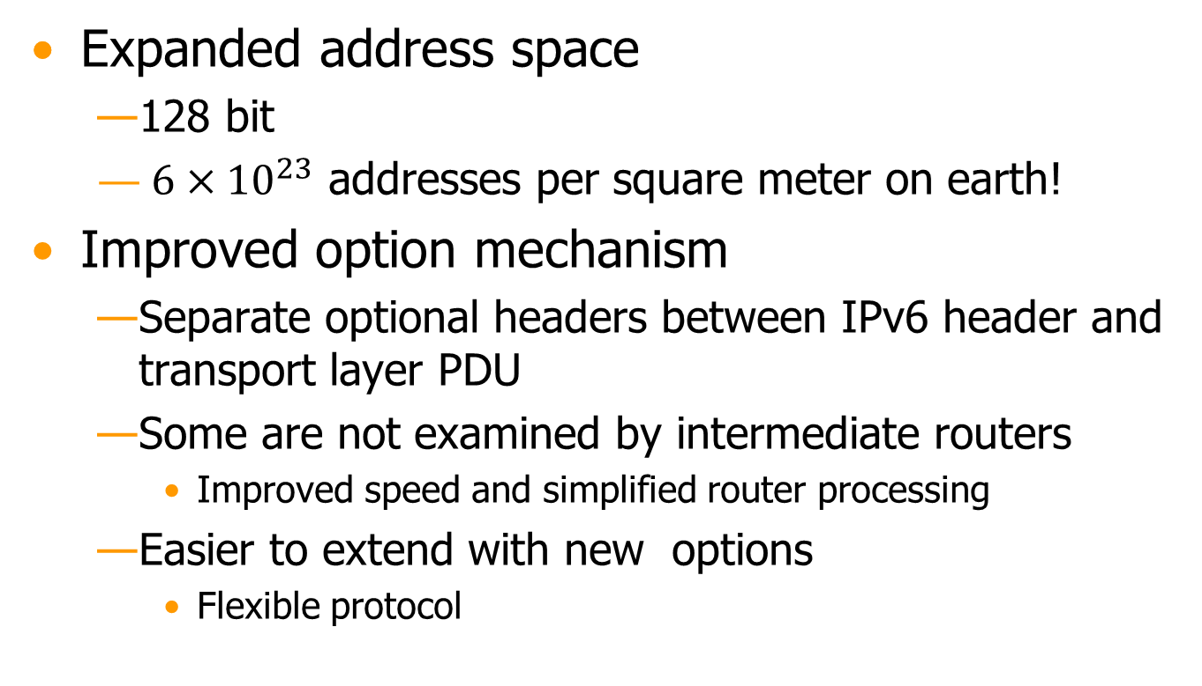
IPv6 Enhancements (1)

Slide 43
IPv6 Enhancements (2)
Support for resource allocation
  Labeling of packets for particular traffic flow
  Allows special handling
    e.g. real time video

Slide 44
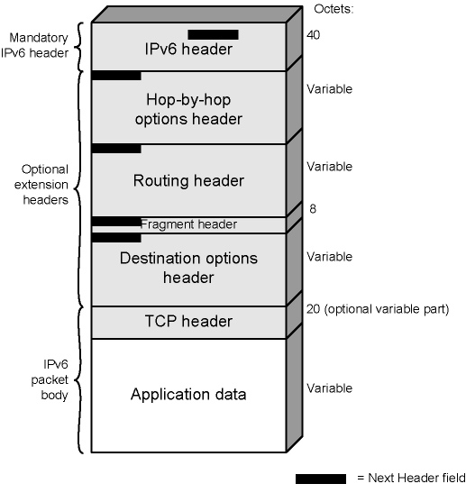
IPv6 Packet with Extension Headers
IPv6 header + optional extension headers

Slide 45
Extension Headers
Hop-by-Hop Options
  special options that require hop-by-hop processing
Routing
  Similar to source routing
Fragment
  fragmentation and reassembly information
Authentication
  Integrity and Authentication
Encapsulating security payload
  Privacy and Confidentiality (plus optional authentication)
Destination options
  Optional info to be processed at destination node

Slide 46
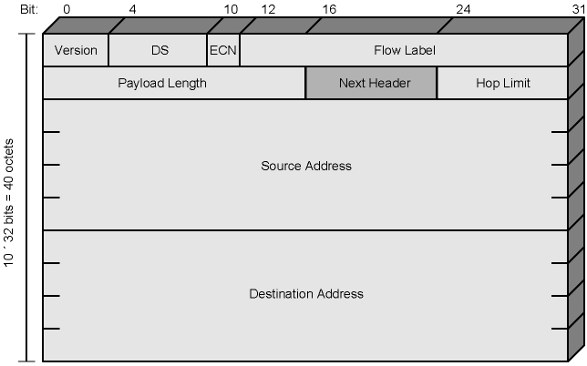
IPv6 Header

Slide 47
IP v6 Header Fields (1)
Version
  6 (in binary: 0110)
DS/ECN
  Previously, Traffic Class (Types of Service)
    Classes or priorities of packet
  Now interpretation is different as discussed in v4
Flow Label
  Identifies a sequence of packets (a flow) that has special handling requirements
Payload length
  Length of all extension headers plus user data

Slide 48
IP v6 Header Fields (2)
Next Header
  Identifies type of header
    Extension header or next layer up
Hop Limit
  Remaining number of hops
  As in TTL of IPv4, decremented by one at each router
  Packet discarded if reaches zero
Source Address
Destination address
Longer header but less number of fields
  simplified processing

Slide 49
Flow Label
Flow
  Sequence of packets from a particular source to a particular destination
  Source desires special handling by routers
  Uniquely identified by source address, destination address, and 20-bit flow label
Router's view
  Sequence of packets that share some attributes affecting how packets handled
    Path, resource allocation, discard needs, security, etc.
  Handling must somehow be arranged a priori
    Negotiate handling ahead of time using a control protocol (not to be discussed in CS 408)

Slide 50
Differences Between v4 and v6 Headers
No header length (IHL) in v6
  main header is of fixed length in v6 and extension layers are counted in the payload length header
No Protocol info in v6
  next header field will eventually point to the transport layer protocol
No fragmentation related fields in v6 base header
  fragmentation is an extension header
No checksum in v6
  rely on reliable transmission medium and checksums of upper and lower layers
Flow label is part of base header in v6
  it was in the options part in v4

Slide 51
IPv6 Addresses
128 bits long
Assigned to interface
  An interface may have multiple addresses
network/host id parts
  arbitrary boundary
  like CIDR addresses in v4
Multilevel hierarchy
  ISP - Organization - Site - …
  Helps faster routing due to aggregation of IP addresses
    Smaller routing tables and faster lookup
IPv4 addresses are mapped into v6 addresses
Three types of address: unicast, anycast, multicast

Slide 52
Types of address
Unicast
  an address that is assigned to a single interface
Anycast
  Set of computers (interfaces) that share a single address
  Delivered to any one interface
    the “nearest”
Multicast
  One address for a set of interfaces/computers
  Delivered to all interfaces/computers identified by that address

Slide 53
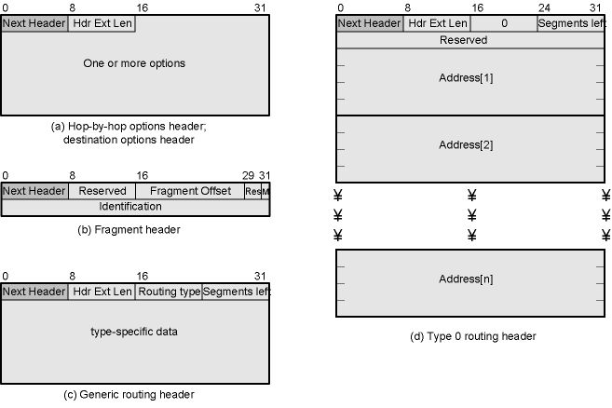
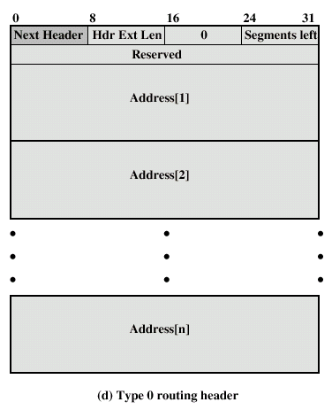
IPv6 Extension Headers

Slide 54
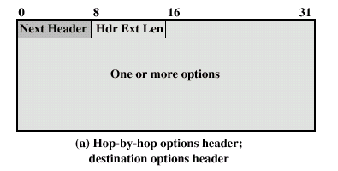
Hop-by-hop Options
Next header
Header extension length
Options
  Type (8 bits), length (8 bits) , option data (variable size)
    type also says what should router do if it does not recognize the option
  Pad1 / Pad N
    Insert one/N byte(s) of padding into Options area of header
    Ensure header is multiple of 8 bytes
  Jumbo payload (Jumbogram)
    Option data field (32 bits) gives the actual length of packet in octets
      excluding the base IPv6 header
    For packets over 2¹⁶ -1 = 65,535 octets, we use this option
      up to 2³² octets
      for large video packets
  Router alert
    Tells the router that the content of packet is of interest to the router
    Provides support for Resource Reservation Protocol (RSVP)

Slide 55
Fragment Header
Fragmentation is only allowed at source
No fragmentation at intermediate routers
Node must perform path discovery to find smallest MTU (max. transmission unit) of intermediate networks
  iterative process
Source fragments to match MTU
Otherwise limit to 1280 octets
  1280 is the minimum supported by each network

Slide 56
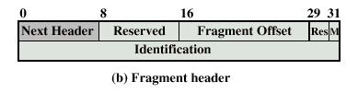
Fragment Header Fields
Next Header
Fragmentation offset
  as in v4
More flag
  as in v4
Identification
  as in v4

Slide 57
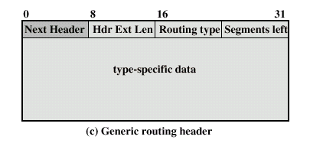
Routing Header
Source routing method of IPv6
List of intermediate nodes to be visited
Next Header
Header extension length
Routing type
Segments left
  i.e. number of nodes still to be visited

Slide 58
Routing Header
Type 0 routing
  The only one defined in RFC 2460
Base header contains the address of next router
Router examines the routing header and replaces the address in the base header before forwarding
Ultimate destination address

Slide 59
Destination Options
Same format as Hop-by-Hop options header
RFC 2460 defines Pad 1/Pad N as in hop-by-hop options header

Slide 60
Migration to IPv6
Not an overnight operation
  lots of investments in v4 networking equipment and software
  currently equipment and software are all IPv6 compatible
  however, turning the key on synchronously all around the world is not easy
Specialized networks of small devices with IPv6 addresses
  e.g. a network of sensors that covers a large area for security protection
Some co-existence strategies
  With prior negotiation IPv6 is used

Slide 61
IPv4 and IPv6 Security
Section 16.6
IPSec
Security within the IP level
  so that all upper level applications will be secured
  Integrity, authentication and encryption
  End-to-end, although IP is not end to send
A very brief summary is given next

Slide 62
IPSec Scope
Authentication header (AH)
  Authentication and integrity
Encapsulated Security Payload (ESP)
  encryption + optional (authentication + integrity)
Key exchange
  Oakley, IKE, ISAKMP
RFC 2401,2402,2406,2408,2409

Slide 63
Security Association
Identifies security relationship between sender and receiver
Details are at local databases
Security Associations are identified by Security Parameter Indices

Slide 64
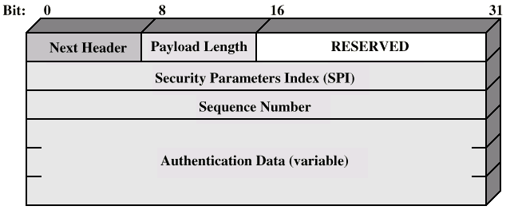
Authentication Header

Slide 65
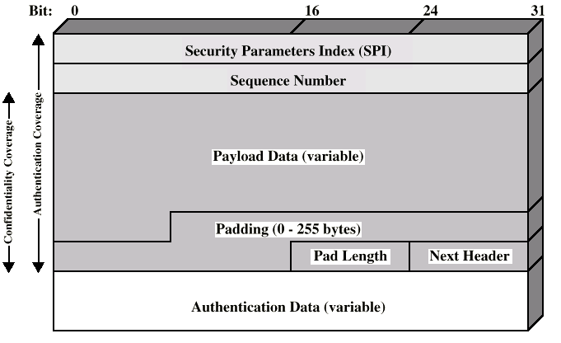
ESP Packet
Next Header identifies the first header in the payload

Slide 66
Transport and Tunnel Modes
Transport mode
  Protection coverage is the payload of IP packet
    generally headers are not included
  Protection for upper layer protocol
  End to end between hosts
Tunnel mode
  Protection for the entire IP packet
  Entire packet treated as payload for "outer" IP packet
  No routers examine inner packet and its header
  End to end but between source router to destionation router connection
  VPNs (Virtual Private Networks) are constructed in this way

